Slide 1
Foundations of Complex Software Architectures and Styles
Damian A. Tamburri, Ph.D.
Damian.tamburri@unimol.it
dtamburri@acm.org

Slide 2
Roadmap for Today
Course Structure Intro
Basic Notions around Software Architectures
SAs & Design
Design Principles
Before we leave...
Project Assignment!
Q&A

Slide 3
What are we up to, here?
Course Objective
Providing overview over Software Architectures (SA) and the process of designing them
How - Means of study
Studying and applying SA and design languages, techniques, and principles, well established and emerging
Where - Targeted Architecture Landscape
Big Data, Data-Intensive Architectures
Why - Targeted Architecture Property
Security & Privacy-by-design

Slide 4
Course Overview
CFU 1
Fundamentals of Software Architectures and Design Principles: Problems Concerning the Design of Complex Software Architecture and Introduction to the ISO / IEC 42010 Standard.
CFU 2
Design Principles in Action: Designing complex software systems in general. Design of Data-Intensive Software Systems.
CFU 3
Complex architectural styles: Master-Slave styles, Peer-to-peer styles, Data-Intensive styles and Architectural Patterns. Hints over MicroServices and OASIS TOSCA standard.

Slide 5
Course Overview Cont’d
CFU 4
Architecture trade-off analysis: consideration of architectural decisions. Description of architectural decisions. Communication and Documentation of Architectural Decisions.
CFU 5
Design of private-by-design systems: Overview of NoSQL and Data-Intensive middleware, privacy-by-design techniques and framework document EU ENISA Privacy and Data Protection by Design.
CFU 6
Continuous enhancement of software architectures: DevOps Principles and Continuous Architecting. Design principles shift-left and deploy-first.

Slide 6
General Course Structure
Part 1: Theory & Practice Fundamentals
Design & Software Architectures Principles
Architecture Decision-Making, Trade-Off Analysis
Architecture Description Fundamentals
Architectural Styles: Foundations & Basics
Part 2: Data-Intensive Architecture Fundamentals
Introduction to Cloud Computing and Styles
Cloud Orchestration and Infrastructure-as-Code
Data-Intensive Applications Foundations and Styles
Data-Intensive Middleware and NoSQL
Part 3: Advanced Architecting Methods
Model-Driven Architecture Principles and Practice
DevOps and Continuous Architecting
Privacy-By-Design & SAs
Advanced Software Architecture Properties

Slide 7

Small Note on Program!
No lecture on Nov. 2 and Nov. 6
No lecture on Nov. 30 and Dec. 4
Since... I won’t be here physically, but I’ll always be with you in spirit ☺

Slide 8


Evaluation
~70%: Adopt an Open-Source Project!*
Study the project and its architecture Regularly throughout the course
Participate in the community
Reproduce & document the arch. Design (2 intermediate +1 final hand-in)
~30%: Oral discussion + examination!
Regular discussions/presentations throughout the course (in English!)
Final presentation / exam (2 intermediate + 1 final presentation)
* More details towards the end of the lecture
Notes:
Project ➔ 24/30
Oral Discussion ➔ 6/30, 2 points per group, per presentation;
+15 only for overperformers with Evaluation Extra’s;

Slide 9



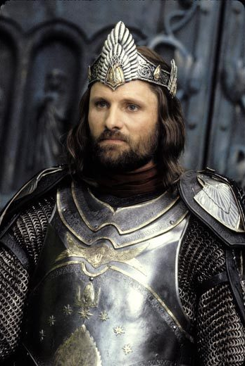

Evaluation Extra’s! [Optional] *
Fool-of-a-Too(l)k(it)! +1: bug-hunting + patching of open-source project issue, documenting the process;
Bilbo Bug-gins! +2: bug-hunting + patching of open-source project software architecture issue, documenting the process;
Gandalfeat! +3: address a feature request, implement resolution, document the process;
AraGone! +4: propose architecture change, implement & merge change, document the process;
FroDone! +5: re-documentation of entire architecture through reverse engineering + document the process;
* If you do all of these you could pass the exam W/O project!

Slide 10
And finally... Lectures overview!
L1 |  | Fundamental Concepts, the role of SA, Relations between RE and SAs, Design concepts and Design Principles; Project assignment overview and challenge the students;
L2 |  | Fundamentals of Design, Architecture Decision-Making, Design Decisions, Trade-Off analysis, architecting the organisation vs. organising the architecture
L3 |  | Architecture Design Description using formal, semi-formal, and informal languages: UML & ISO/IEC 42010
L4 |  | Architecture Design Description using formal, semi-formal, and informal languages: ADLs
L5 |  | Complex Software Architecture Styles: intro & key concepts, overview of basic styles and Examples
L6 |  | Initial Project Revision - preliminary insights over chosen open-source software architecture!
L7 |  | Complex Software Architecture Styles: introduction to Cloud Computing and cloud computing styles
L8 |  | Complex Software Architecture Styles: cloud orchestration concepts, microservices, containerisation, and the TOSCA standard

Slide 11
Lectures overview... Cont’d!
L9 | Complex Software Architecture Styles: introduction to Data-Intensive applications (batch+stream intro) and Data-intensive styles
L10 | Complex Software Architecture Styles: Data-Intensive Middleware and NoSQL DB
L11 | Intermediate Project Revision - draft of software architecture documentation
L12 | Complex Software Architecting Methods: MDA
L15 | Advanced Software Architecture Properties: DevOps Deploy-First and Shift-Left Architectures
L16 | Advanced Project Revision - if it were my product… what would I do with it!

Slide 12
And finally... Lectures overview!
L1 |  | Fundamental Concepts, the role of SA, Relations between RE and SAs, Design concepts and Design Principles; Project assignment overview and challenge the students;
L2 |  | Fundamentals of Design, Architecture Decision-Making, Design Decisions, Trade-Off analysis, architecting the organisation vs. organising the architecture
L3 |  | Architecture Design Description using formal, semi-formal, and informal languages: UML & ISO/IEC 42010
L4 |  | Architecture Design Description using formal, semi-formal, and informal languages: ADLs
L5 |  | Complex Software Architecture Styles: intro & key concepts, overview of basic styles and Examples
L6 |  | Initial Project Revision - preliminary insights over chosen open-source software architecture!
L7 |  | Complex Software Architecture Styles: introduction to Cloud Computing and cloud computing styles
L8 |  | Complex Software Architecture Styles: cloud orchestration concepts, microservices, containerisation, and the TOSCA standard
Every Group Presents (15 min)!
Preliminary thoughts and insights over SA
Challenges in community participation
Overview of Open Issues, focus on arch. Issues (if any)

Slide 13
Lectures overview... Cont’d!
L9 | Complex Software Architecture Styles: introduction to Data-Intensive applications (batch+stream intro) and Data-intensive styles
L10 | Complex Software Architecture Styles: Data-Intensive Middleware and NoSQL DB
L11 | Intermediate Project Revision - draft of software architecture documentation
L12 | Complex Software Architecting Methods: MDA
L15 | Advanced Software Architecture Properties: DevOps Deploy-First and Shift-Left Architectures
L16 | Advanced Project Revision - if it were my product… what would I do with it!
Every Group Presents (15 min)!
Their own SA for tool under study
Rationale and desirable architectural features

Slide 14
Lectures overview... Cont’d!
L9 | Complex Software Architecture Styles: introduction to Data-Intensive applications (batch+stream intro) and Data-intensive styles
L10 | Complex Software Architecture Styles: Data-Intensive Middleware and NoSQL DB
L11 | Intermediate Project Revision - draft of software architecture documentation
L12 | Complex Software Architecting Methods: MDA
L15 | Advanced Software Architecture Properties: DevOps Deploy-First and Shift-Left Architectures
L16 | Advanced Project Revision - if it were my product… what would I do with it!
Every Group Presents (15 min)!
Architectural Trade-Off Analysis with new features & NFRs
Architectural Improvement Plan

Slide 15

Any Questions?

Slide 16
Now... Let’s get down to Business!
Lecture 1 (seriously)
Fundamental Concepts;
The role of SA;
Relations between RE and SAs;
Design concepts and Design Principles;
Project assignment overview;

Slide 17
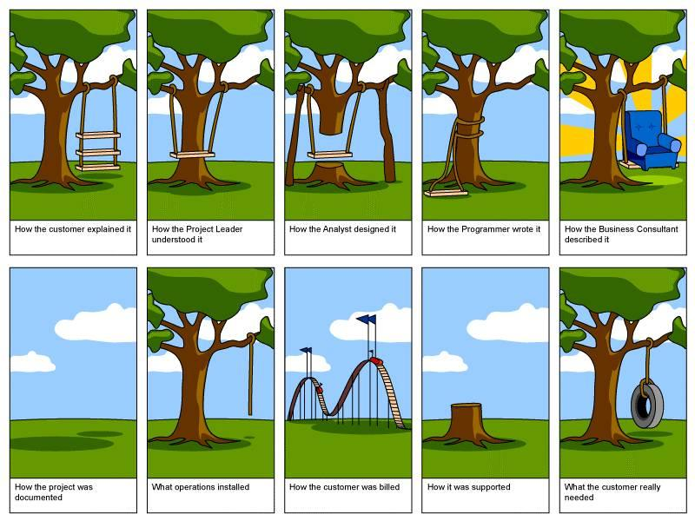
Software design

Slide 18
Design and architecture
Sometimes used as synonyms
The design activity produces the software architecture (or software design)
Sometimes architecture used as a higher level concept than design
Although of course there is a continuum of abstraction/detail

Slide 19
A possible distinction
Design
decomposition of system into modules
relations/interactions among modules
which uses which
which inherits from which
…
typically modules are directly mapped into programming elements
Architecture
higher level description of logical components and how they interact
The architecture of a software system defines the system in terms of computational components and interactions among those components. (Garlan&Shaw1996)

Slide 20
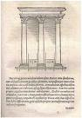
Where did it start?
1992: Perry & Wolf
1987: J.A. Zachman; 1989: M. Shaw
1978/79: David Parnas, program families
1972 (1969): Edsger Dijkstra, program families
1969: I.P. Sharp @ NATO Software Engineering conference:
“I think we have something in addition to software engineering [..] This is the subject of software architecture. Architecture is different from engineering.”
Notes:
1992: Foundatins for the study of software architecture, Software Engineering Notes
1987: Zachman in IBM Systems Journal: Framework for Information Architecture
1989: Shaw , Larger Scale Systems require Higher Level Abstractions
1972: Dijkstra in Notes on Structured Programming, Note #10. This same text is also present in the proceedings of the 1969 SE conference
Intriguing question: What if the NATO conference was called Software Architecture?

Slide 21
Design vs. Architecture: an example
Consider a simple Java system supporting users opening and operating on bank accounts

Slide 22
Higher level model – Architecture?
Bank
Client
OpenAccount
CheckBalance(Account)
A Bank Server is able to receive from clients two requests
Open account: it returns an account identifier. If the account does not exist, the system creates it
Balance: it checks the balance of a previously opened account
Other details are made transparent:
The factory
The distinction between services offered by the manager and those offered by the account

Slide 23
Other models: Executables (deployment units)

Slide 24
Other models: Executables (deployment units)
Is this architecture?

Slide 25
Other models: Processes and threads (runtime units)

Slide 26
Other models: Processes and threads (runtime units)
And this?

Slide 27
So, essentially… How do we distinguish between the two?
Architecture: artifacts describing decisions made and consequent structural decomposition + properties of resulting software.
Design: Process and series of decisions leading to architecture
Documenting Both is critical!

Slide 28
Pre-architecture life cycle
stakeholders
(few)
requirements
quality
agreement
design
Notes:
58% of times, especially in SMEs, this is still what happens in industry – hard consequence is that cost of change is extremely high

Slide 29
Characteristics
Iteration mainly on functional requirements
Few stakeholders involved
No balancing of functional and quality requirements

Slide 30
Adding architecture, the easy way
stakeholders
(few)
requirements
quality
agreement
architecture
detailed design
design
implementation
Notes:
Iteratie in dit model zit vooral in de requirements, en met slechts een paar stakeholders: onwerpers, opdrachtgever en gebruiker, met name.
Anzelfsprekend is er ook iteratie omdat bv kwaliteitskenmerken niet re realiseren zijn, eea te duur wordt, enz. Maar dat is vaak nadat de overeenkomst gesloten is.

Slide 31
Giving a more crucial role to the architecture
stakeholders
(many)
requirements
quality
architecture
agreement
development

Slide 32
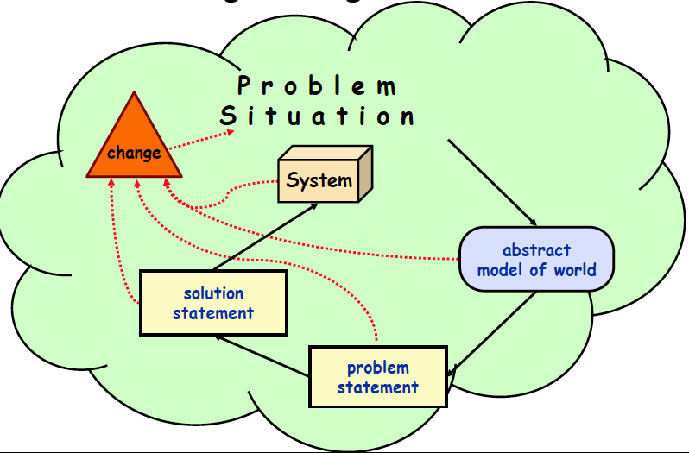
Design Changes the World!
Notes:
Separating a problem from the solution makes sense
For a software-intensive
system, the solution description includes anything that expresses the design: the program code,
design drawings, the system architecture, user manuals, etc. The problem description is usually less
well-documented – for some projects it may be captured in a ‘concept of operations’ document, or a
‘requirements specification’. For other projects, it may exist only in notes taken from discussions
with customers or users, or in a collection of ‘user stories’ or ‘scenarios’. And for some projects
there is no explicit statement of what the problem is, just a vague understanding of the problem in
the minds of the developers.
The second key insight of requirements engineering is that this separation of problem
statement from solution statement cannot really be done in practice. The real world in which human
activities take place is complex, and any attempt to model and understand some piece of it will
inevitably be imperfect. The world (and the people in it) change continually, so that the problem
statement we write down at the beginning of a project may be wrong by the end of it. And because
software technology opens up all kinds of new possibilities for how work is organized, the process
of design itself will change the nature of the problem: show a user an early prototype of the system,
and she will usually think of all sorts of new things she would like it to do. In some cases, it is only
by attempting to design a new system that we start to understand whether there really is a problem
that needs solving. For example, nearly all of the most practical uses of the world wide web weren’t
discovered until after the web was created, and most people never realized they needed cellphones
with built-in cameras until they saw all the cool things you can do with them.

Slide 33
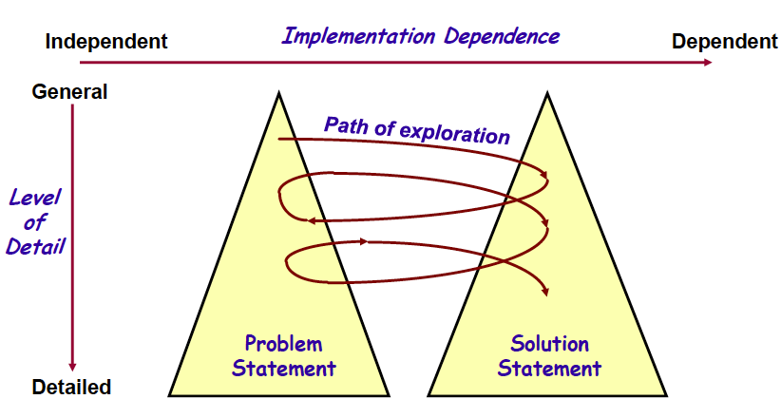
Design Changes the World!

Slide 34
Design Changes the World!
Design!
SA!
Code!

Slide 35
Giving a more crucial role to the architecture
Design!
SA!
stakeholders
(many)
Code!
requirements
quality
architecture
agreement
development

Slide 36
Characteristics of the RE<->SA Iteration
Iteration on both functional and quality requirements
Many stakeholders involved
Balancing of functional and quality requirements
Notes:
Hier valt natuurlijk nog veel meer over te zeggen, bv in relatie tot hergebruik, product lines, enz.

Slide 37
Why Is Architecture Important?
Architecture is the vehicle for stakeholder communication
Architecture manifests the earliest set of design decisions
Introduces constraints on implementation
Dictates organizational structure
Inhibits or enables quality attributes
Architecture is a transferable abstraction of a system
Product lines share a common architecture
Allows for template-based development
Basis for training
Notes:
Vehicle: it is global, often graphical, often uses scenarios.
Early design decisions are important (cost of rework)
Means for planning and control: via the work breakdown structure which is derived from the architecture.
Transferable abstraction: architecture as a linguistic notion, as a basis for reuse, product lines, its use in traing people.

Slide 38
Again, Software architecture, definition (1)
“The architecture of a software system defines that system in terms of computational components and interactions among those components.”
(from Garlan and Shaw, Software Architecture, Perspectives on an Emerging Discipline, Prentice-Hall, 1996.)

Slide 39
Example – Chromium Architecture
https://www.chromium.org/developers/design-documents/multi-process-architecture
Notes:
Btw chromium is an open-source web-browser from which Chrome was derived

Slide 40
Software Architecture, definition (2)
“The software architecture of a system is the structure or structures of the system, which comprise software elements, the externally visible properties of those elements, and the relationships among them.” *
* from Bass, Clements, and Kazman, Software Architecture in Practice, SEI Series in Software Engineering. Addison-Wesley, 2003.
Notes:
Note: in edition 1, they talked about components, not elements.
Reason for change is that component has a rather (runtime) specific meanng within CBSE: a component is something that can be invoked/activated; but this line is not really followed throughout the book. Ergens verderop staat bv “component is a unit for reuse”

Slide 41
Software Architecture
Important issues raised in this definition:
multiple system structures;
externally visible (observable) properties of components.
The definition does not include:
the process;
rules and guidelines;
architectural styles.
Notes:
Externally visible: so you are abstracting from something
architecture defines components; only their interaction counts, not their internals.
Every system has an architecture, and this architecture is not the same as its description (see also next IEEE definition)
Architecture can be good or bad: hence evaluation
Process: how do you get an architecture.
Rules: what should be/not be, in an architecture?

Slide 42
Typical Architectural Structures
module structure
conceptual, or logical structure
process, or coordination structure
physical structure
uses structure
calls structure
data flow
control flow
class structure
What kinds of structures can we recognize in the simple banking example?
Notes:
Module structure: static, aimed at the implementation
Open question: what is the relation between structures?
Later on, in IEEE, and by now generally accepted, these structures are called viewpoints.

Slide 43
Software Architecture Structures: Interlinks and Dependencies
statement
⇓
procedure
⇓
module
⇓
(design) pattern
⇓
architecture
Notes:
This is all about abstraction.
These abstractions first had a specific goal, and later turned into a notion of its own. E.g., procedures at first only served as a shorthand; memory was expensive, and people didn’t want to repeat the same sequence of instructions over and over again. Only later, did the notion of procedural abstraction evolve. Once people have discovered this broader notion, they can use it more effectively.
The same holds for the other abstraction notions, including patterns and architecture.

Slide 44
In summary, software architecture is...
Architecture is conceptual.
Architecture is about fundamental things.
Architecture exists in some context.
Notes:
The architectural descriptions are concrete, but the architecture itself is ingherently conceptual, and cannot be captured in any (set of) views.
Fundamental: so you concentrate on the important things, and abstract from the rest.
An architecture does not exist in the abstract, but always in some context. We can only understand its qualities in its context.

Slide 45
Other points of view
Architecture is high-level design
Architecture is overall structure of the system
Architecture is the structure, including the principles and guidelines governing their design and evolution over time
Architecture is components and connectors

Slide 46

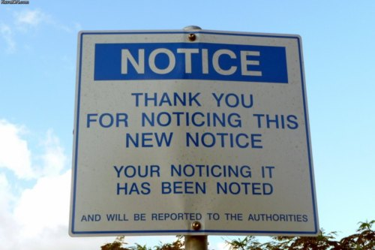
Bored yet?
10 min Break?
Coming up next.. Design Principles!

Slide 47
Software Architecture & Quality
The notion of quality is central in software architecting: a software architecture is devised to gain insight in the qualities of a system at the earliest possible stage.
Some qualities are observable via execution: performance, security, availability, functionality, usability
And some are not observable via execution: modifiability, portability, reusability, integrability, testability

Slide 48
Software Architecture & Quality
The notion of quality is central in software architecting: a software architecture is devised to gain insight in the qualities of a system at the earliest possible stage.
Some qualities are observable via execution: performance, security, availability, functionality, usability
And some are not observable via execution: modifiability, portability, reusability, integrability, testability
For the rest of this course, we focus on Privacy-By-Design!

Slide 49
The Process of Architectural Design
Definition:
Defining the software architecture or design is a problem-solving process whose objective is to find and describe a way:
To implement the system functional requirements...
While respecting the constraints imposed by the quality, platform and process requirements...
including the budget, organization, etc.
And while adhering to general principles of good quality

Slide 50
Design as a series of decisions
A designer is faced with a series of design issues
These are sub-problems of the overall design problem.
Each issue normally has several alternative solutions:
Design options.
The designer makes a design decision to resolve each issue.
This process involves choosing the best option from among the alternatives.

Slide 51
Making decisions
To make each design decision, the software engineer uses:
Knowledge of
the requirements
the design as created so far
the technology available
software design principles and ‘best practices’
what has worked well in the past

Slide 52
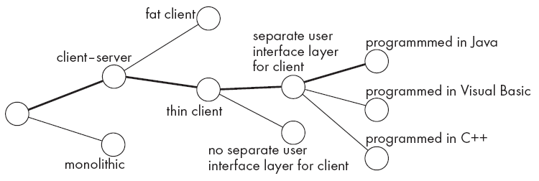
Design space
The space of possible designs that could be achieved by choosing different sets of alternatives is often called the design space
For example:

Slide 53
Top-down and bottom-up design
Top-down design
First design the very high level structure of the system.
Then gradually work down to detailed decisions about low-level constructs.
Finally arrive at detailed decisions such as:
the format of particular data items;
the individual algorithms that will be used.

Slide 54
Top-down and bottom-up design
Bottom-up design
Make decisions about reusable low-level utilities.
Then decide how these will be put together to create high-level constructs.
A mix of top-down and bottom-up approaches are normally used:
Top-down design is almost always needed to give the system a good structure.
Bottom-up design is normally useful so that reusable components can be created.

Slide 55
Examples bottom-up design
The Numerical Algorithm Group (NAG) libraries contain a wide range of routines for solving problems in linear algebra, differential equations, ...
The Unix shell provides a facility called a pipe, written “|”, whereby
the standard output of one program may be redirected to the standard input of another
this convention favours composability

Slide 56

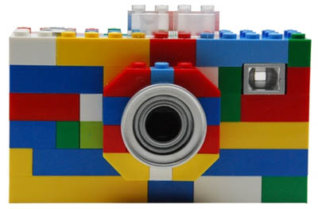
Top-down vs. bottom-up
A top-down design
A bottom-up design
A very nice end result!
It will take time to get it right…
Individual components harder to re-use
A bit rough end result
It will be quicker to get to…
Individual components easier to re-use
You are to find the right trade-off!

Slide 57
Different aspects of design
Architecture design:
The division into subsystems and components,
How these will be connected.
How they will interact.
Their interfaces.
Class design:
The various features of classes.
User interface design
Algorithm design:
The design of computational mechanisms.
Protocol design:
The design of communications protocol.

Slide 58
Design Principles: The rules of the game
Typical Design principles cover the overall goals of good design:
Increasing profit by reducing cost and increasing revenue
Ensuring that we actually conform with the requirements
Accelerating development
Increasing qualities such as
Usability
Efficiency
Reliability
Maintainability
Reusability

Slide 59
A simple example: a trivial prototype of a “banking application” - Account
import java.rmi.*;
public interface Account extends Remote {
public float balance() throws RemoteException;
}
import java.rmi.*;
import java.rmi.server.UnicastRemoteObject;
public class AccountImpl extends UnicastRemoteObject implements Account {
private float _balance;
public AccountImpl(float balance) throws RemoteException {
_balance = balance;
}
public float balance() throws RemoteException {
return _balance;
}
}

Slide 60
A simple example: a trivial prototype of a “banking application” - AccountFactory
import java.rmi.*;
public interface AccountFactory extends Remote {
public Account createAccount(String userName, int balance)
throws RemoteException;
public int getLoad() throws RemoteException;
}
import java.util.*; import java.net.InetAddress; import java.rmi.*;
import java.rmi.server.UnicastRemoteObject;
public class AccountFactoryImpl extends UnicastRemoteObject implements AccountFactory {
private String hostName;
private int load;
public AccountFactoryImpl(String _hostName)
throws RemoteException {
hostName = _hostName; load = 0;
}

Slide 61
A simple example: a trivial prototype of a “banking application” - AccountFactory
public Account createAccount(String userName, int balance)
throws RemoteException {
Account account = new AccountImpl(balance);
try {
Naming.rebind("//"+hostName+"/Account"+userName, account); System.out.println("Created " + userName + "'s account: " + account);
} catch (Exception e) { e.printStackTrace(); }
load++;
return account;
}
public int getLoad() throws RemoteException { return load; }

Slide 62
A simple example: a trivial prototype of a “banking application” - AccountFactory
public static void main(String[] args) {
String _hostName;
try {
System.setSecurityManager(new RMISecurityManager());
_hostName = InetAddress.getLocalHost().getHostName();
AccountFactoryImpl server = new
AccountFactoryImpl(_hostName); Naming.rebind("//"+_hostName+"/AccountFactory", server); System.out.println("Factory bound on "+_hostName);
} catch (Exception e) { e.printStackTrace(); }
}
}

Slide 63
A simple example: a trivial prototype of a “banking application” - AccountManager
import java.rmi.*;
public interface AccountManager extends Remote {
public Account open(String name) throws RemoteException;
}
import java.util.*; import java.net.InetAddress; import java.rmi.*;
import java.rmi.server.UnicastRemoteObject;
public class AccountManagerImpl extends UnicastRemoteObject implements AccountManager {
private Dictionary _accounts = new Hashtable();
private String hostName;
private Vector factoryList;
public AccountManagerImpl(String _hostName)
throws RemoteException {
hostName = _hostName;
factoryList = new Vector();
}

Slide 64
A simple example: a trivial prototype of a “banking application” – AccountManager
public void addFactory(String hostName) {
try { AccountFactory fct = (AccountFactory)
Naming.lookup("//"+hostName+"/AccountFactory"); factoryList.addElement(fct);
} catch (Exception e) {
System.out.println("Error: Factory unreachable");
e.printStackTrace();
}
}

Slide 65
A simple example: a trivial prototype of a “banking application” - AccountManager
public AccountFactory selectFactory() {
int minLoad, load; int index=0; AccountFactory f;
try { Enumeration e = factoryList.elements();
f = (AccountFactory) e.nextElement();
minLoad = f.getLoad();
index=factoryList.indexOf(f);
while(e.hasMoreElements()) {
f = (AccountFactory) e.nextElement();
load = f.getLoad();
if(minLoad > load) {
minLoad = load;
index=factoryList.indexOf(f);
} } } catch (Exception e) {
e.printStackTrace(); }
return (AccountFactory) factoryList.elementAt(index);
}

Slide 66
A simple example: a trivial prototype of a “banking application” - AccountManager
public Account open(String name) throws RemoteException {
AccountFactory factory;
/* ...Security checks... */
Account account = (Account) _accounts.get(name);
if(account == null) { factory = selectFactory();
try {
account = factory.createAccount(name, 0); _accounts.put(name, account);
} catch (Exception e) { e.printStackTrace(); } }
return account;
}

Slide 67
A simple example: a trivial prototype of a “banking application” - AccountManager
public static void main(String[] args) {
String _hostName;
try {
System.setSecurityManager(new RMISecurityManager());
_hostName = InetAddress.getLocalHost().getHostName();
AccountManagerImpl server = new AccountManagerImpl(_hostName);
server.addFactory(args[0]);
Naming.rebind("//"+_hostName+"/AccountManager", server);
System.out.println("Server bound on "+_hostName);
} catch (Exception e) { e.printStackTrace(); }
}}

Slide 68
A simple example: a trivial prototype of a “banking application” - Client
import java.rmi.*;
public class Client {
public static void main(String[] args) {
try {
System.setSecurityManager(new RMISecurityManager()); System.out.println("Looking up server...");
AccountManager server = (AccountManager) Naming.lookup("//"+args[0]+"/AccountManager");
System.out.println("Server bound...");
String name = "Jack B. Quick";
Account account = server.open(name);
float balance = account.balance();
System.out.println ("The balance in " + name + "'s account is $" + balance);
} catch (Exception e) { e.printStackTrace(); } } }

Slide 69
Principles
Design Principle 1: Divide and conquer
Design Principle 2: Increase cohesion where possible
Design Principle 3: Reduce coupling where possible
Design Principle 4: Keep the level of abstraction as high as possible
Design Principle 5: Increase reusability where possible
Design Principle 6: Reuse existing designs and code where possible
Design Principle 7: Design for flexibility
Design Principle 8: Anticipate Dbsolescence
Design Principle 9: Design for Portability
Design Principle 10: Design for Testability
Design Principle 11: Design Defensively

Slide 70
Design Principle 1: Divide and conquer
Trying to deal with something big all at once is normally much harder than dealing with a series of smaller things
Separate people can work on each part.
An individual software engineer can specialize.
Each individual component is smaller, and therefore easier to understand.
Parts can be replaced or changed without having to replace or extensively change other parts.

Slide 71
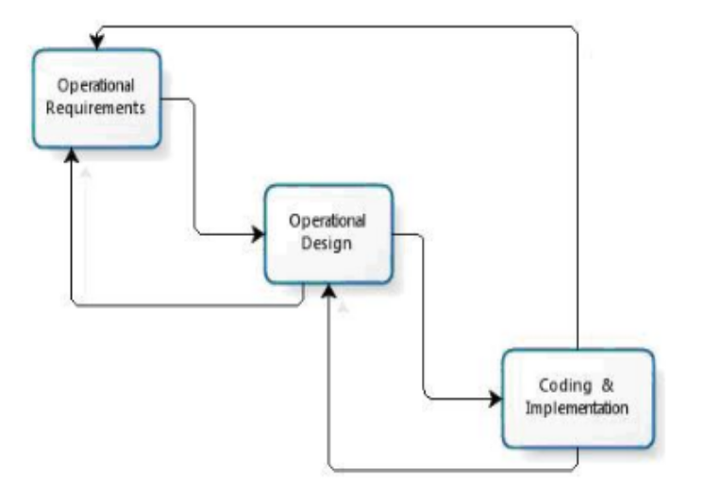
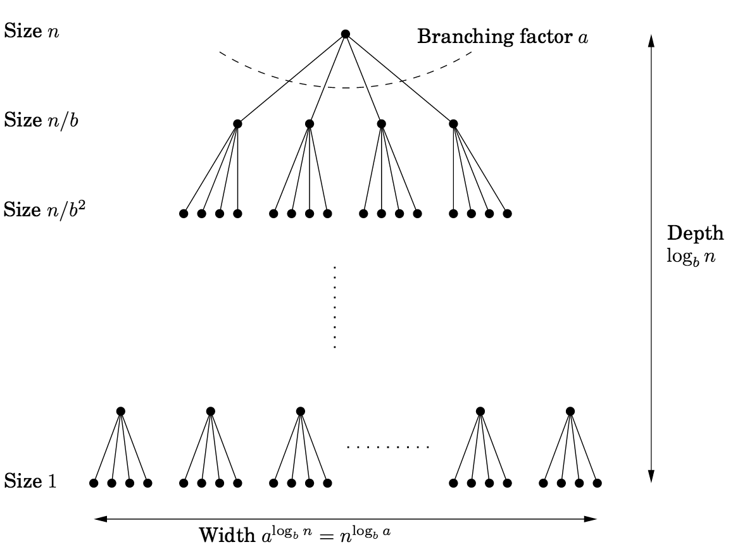
Principle 1: Examples
Sw. Processes
Algorithm Design

Slide 72
Design Principle 2: Increase cohesion where possible
A subsystem or module has high cohesion if it keeps together things that are related to each other, and keeps out other things
This makes the system as a whole easier to understand and change
Example of a non-cohesive module
Class Utility {
ComputeAverageScore(Student s[])
ReduceImage(Image i)
}

Slide 73
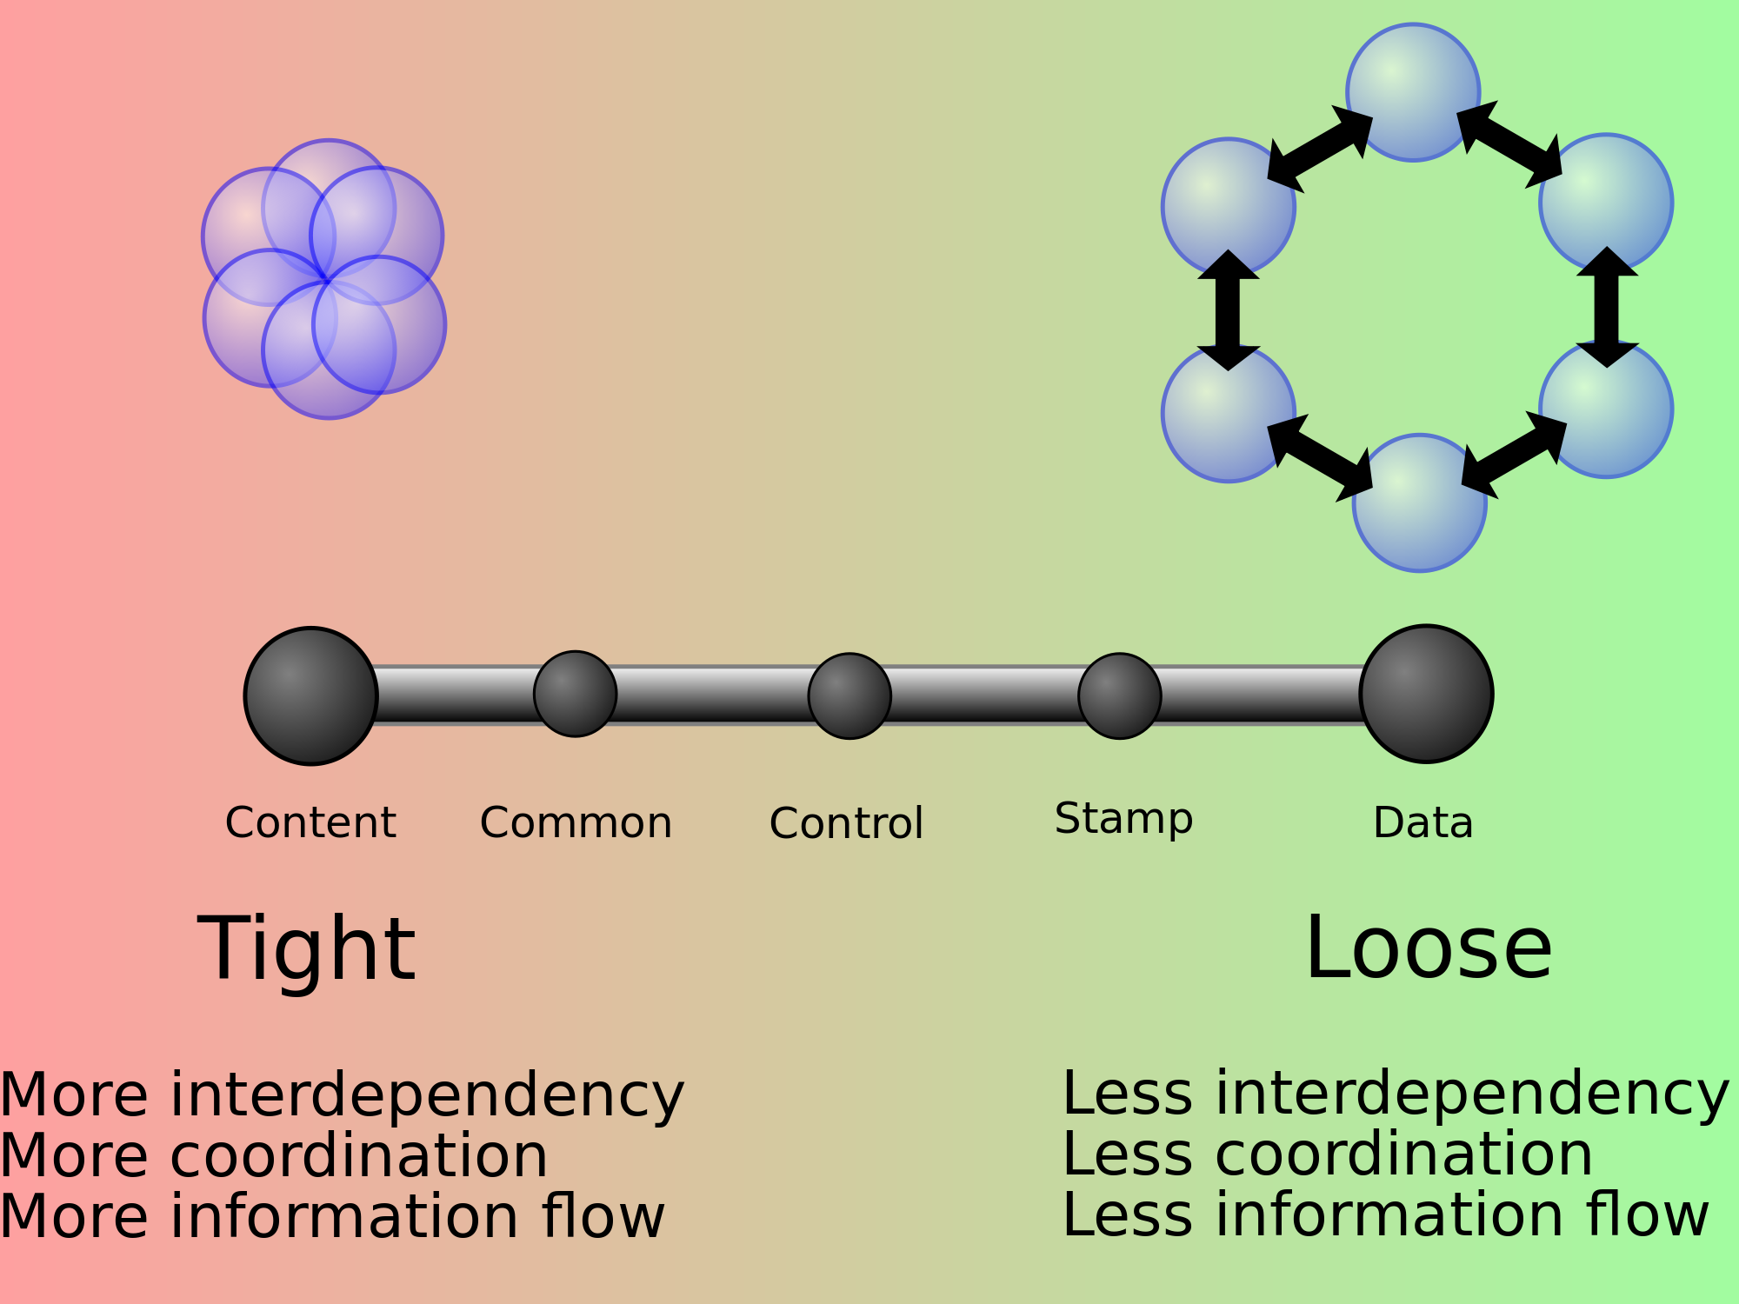
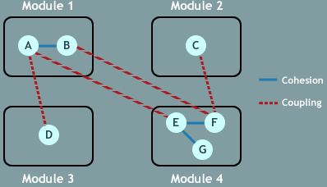
Principle 2: Examples

Slide 74
Design Principle 3: Reduce coupling where possible
Coupling occurs when there are interdependencies between one module and another
When interdependencies exist, changes in one place will require changes somewhere else.
A network of interdependencies makes it hard to see at a glance how some component works.

Slide 75
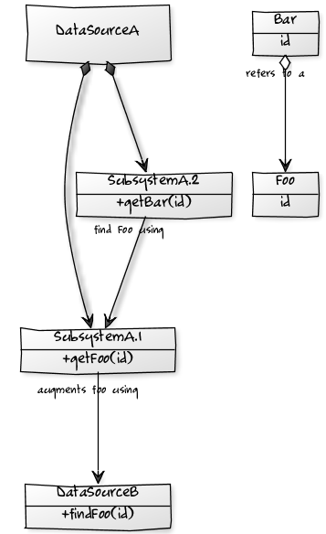
Principle 3: Examples
We have 2 data sources, where data source A is the primary source for items of type Foo.
A secondary data source exists which can be used to retrieve additional information on a Foo;
However this information does not always exist.
Furthermore, data source A can be used to retrieve items of type Bar.
However, each Bar refers to a Foo.
Each Bar should refer to a Foo which, if available, also contains the information as augmented by data source B.
Now What?
Notes:
You can reduce the coupling required in most cases by abstracting away details of exactly where the data comes from. If you get data from a web service, which is given to you as instances of generated classes, then put a converter in place to make a deep copy of the service class into something you control, which won't have to change if the data source does (only if the schema does).

Slide 76
Finding bad coupling: Code-Smells!!
Content/Pathological Coupling : (worst) When a module uses/alters data in another
Control Coupling : 2 modules communicating with a control flag (first tells second what to do via flag)
Common/Global-data Coupling : 2 modules communicating via global data
Stamp/Data-structure Coupling : Communicating via a data structure passed as a parameter. The data structure holds more information than the recipient needs.

Slide 77
Design Principle 4: Keep the level of abstraction as high as possible
Ensure that your designs allow you to hide or defer consideration of details, thus reducing complexity
A good abstraction is said to provide information hiding
Abstractions allow you to understand the essence of a subsystem without having to know unnecessary details

Slide 78
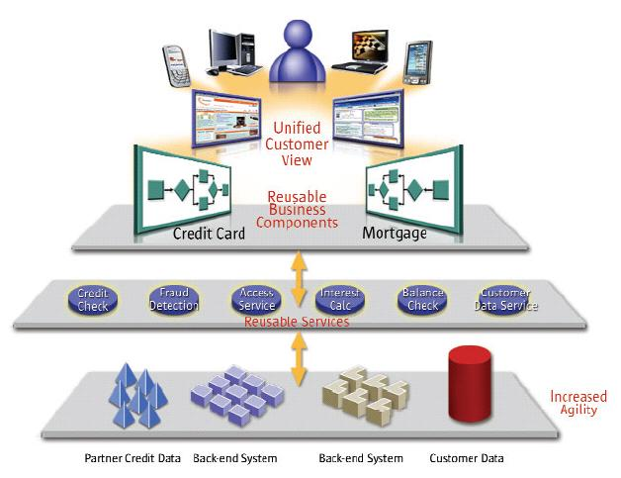
Principle 4: Examples
Service Oriented Architecture!
“the information published in a service contract is limited to what is required to effectively utilize the service” [1]
Notes:
[1] Mauro. et al. Service Oriented Device Integration - An Analysis of SOA Design Patterns. [online], pp. 1–10, 2010 43rd Hawaii International Conference on System Sciences, 2010. Date accessed: 8 April 2010.

Slide 79
Design Principle 5: Increase reusability where possible
Design the various aspects of your system so that they can be used again in other contexts
Generalize your design as much as possible
Follow the preceding three design principles
Design your system to contain hooks
Simplify your design as much as possible

Slide 80
Principle 5: Examples
SOA!
“the information published in a service contract is limited to what is required to effectively utilize the service” [1]
Reusable Services:
Auth.
Login
Messaging
Formatting
Data interactions
…
Notes:
[1] Mauro. et al. Service Oriented Device Integration - An Analysis of SOA Design Patterns. [online], pp. 1–10, 2010 43rd Hawaii International Conference on System Sciences, 2010. Date accessed: 8 April 2010.

Slide 81
Design Principle 6: Reuse existing designs and code where possible
Design with reuse is complementary to design for reusability
Actively reusing designs or code allows you to take advantage of the investment you or others have made in reusable components
Cloning should not be seen as a form of reuse

Slide 82
Sneak Peek! Design Reuse == Design Patterns!
A design pattern is a prescribed way of arranging modules to solve a specific software problem in a specific software context.
More on this later on in the Course…

Slide 83
Coming up next…
Higher-Order Design Principles!

Slide 84
Bored yet?
10 min Break?

Slide 85
Design Principle 7: Design for flexibility
Actively anticipate changes that a design may have to undergo in the future, and prepare for them
Reduce coupling and increase cohesion
Create abstractions
Do not hard-code anything
Leave all options open
Do not restrict the options of people who have to modify the system later
Use reusable code and make code reusable

Slide 86
Flexibility: An example

Slide 87
Flexibility: An example

Slide 88
Design Principle 8: Anticipate obsolescence
Plan for changes in the technology or environment so the software will continue to run or can be easily changed
Avoid using early releases of technology
Avoid using software libraries that are specific to particular environments
Avoid using undocumented features or little-used features of software libraries
Avoid using software or special hardware from companies that are less likely to provide long-term support
Use standard languages and technologies that are supported by multiple vendors

Slide 89
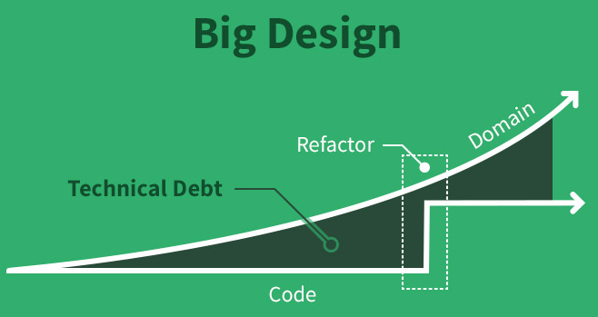
Obsolescence and Refactoring == Technical Debt!

Slide 90
Design Principle 9: Design for Portability
Have the software run on as many platforms as possible
Avoid the use of facilities that are specific to one particular environment
E.g. a library only available in Microsoft Windows

Slide 91
Design Principle 10: Design for Testability
Take steps to make testing easier
Design a program to automatically test the software
Ensure that all the functionality of the code can by driven by an external program, bypassing a graphical user interface
In Java, you can
create a main() method in each class in order to exercise the other methods
Use Junit and related approaches to build an automated testing framework for your system

Slide 92
Design Principle 11: Design defensively
Never trust how others will try to use a component you are designing
Handle all cases where other code might attempt to use your component inappropriately
Check that all of the inputs to your component are valid: the preconditions
Unfortunately, over-zealous defensive design can result in unnecessarily repetitive checking

Slide 93
Design Principle 12: Design for Organizability
Prepare your architecture structures for the organisational that is meant to implement and maintain it
Fine-tune the modularisation strategy based on known/expected collaborations;
Plan for turnover;
Software Architecture Refactoring not in synch with organisation …> Social Debt!

Slide 94
Design Principle 12: Design for Organizability
Prepare your architecture structures for the organisational that is meant to implement and maintain it
Fine-tune the modularisation strategy based on known/expected collaborations;
Plan for turnover;
Software Architecture Refactoring not in synch with organisation …> Social Debt! *
* “Additional project cost connected to sub-optimal organisational structure”

Slide 95
Recap
Software Design is the process that brings you from requirements to Software Architecture, essentially by making a series of (design) decisions, possibly following sound principles:
What are the components / Why
What are the connectors / Why
How they communicate / Why
Internal structure of each component → Module
What/Where are the visible properties of all of the above / Why
…

Slide 96
One more thing...
Software design is the process that brings you from requirements to Software Architecture, essentially by making a series of (design) decisions, possibly following sound principles:
What are the components / Why
What are the connectors / Why
How they communicate / Why
Internal structure of each component → Module
What/Where are the visible properties of all of the above / Why
…

Slide 97
Reasoning at the level of modules
What are the modules?
What is their interface?
Which are the useful relations among modules?
Principles
are the criteria to organize systems into modules
Documentation
document the catalog of modules and their relations such that properties are visible and everything is kept testable

Slide 98
Reasoning at the level of modules
What are the modules?
What is their interface?
Which are the useful relations among modules?
Principles
are the criteria to organize systems into modules
Documentation
document the catalog of modules and their relations such that properties are visible and everything is kept testable
But this… as they say, is another story ☺

Slide 99
That’s it for today!
Next lecture:
Architecture Design Decision fundamentals;
Making sound Design decisions;
Architecture Trade-Off Analysis (ATAM);

Slide 100
But, before we leave... Project Assignment!
Arrange into groups of 2-3;
Create (or use) your own GitHub ID to bootstrap your project on GitHub;
Choose an open-source project, either from my list or choose your own (and elaborate/document the choice);
For the next 2.5 weeks you will need to:
Spend (at least) 60 minutes per week (>=150 mins, in total) studying the open-source project and the community around;
Find out:
the architecture structures/elements of the product;
the organisational structure of the community;
the properties and visible features of the architecture;
the limitations and shortcomings of the product;
how to install/interact with it;

Slide 101
Project Assignment... Cont’d
Prepare a presentation of what you learned:
10-15 slides at most (~20 mins + questions);
Audience shall be myself + your brothers and sisters in arms;
Prepare a full report of your >=150 mins:
You need to document all points a, b, c, d, and e, as precisely as possible and with all the details possible and map them with how long it took you;
You can use free-form text, models, sketches, code, comments on code; whatever works, as you see fit!
You MAY WELL NEED to follow/apply/evaluate guidelines, concepts, and terms we cover in the lectures!!!
Notes:
https://www.unc.edu/courses/2006spring/anth/010/001/fieldnotes_sample.pdf
http://writingspaces.org/sites/default/files/kahn--putting-ethnographic-writing.pdf

Slide 102
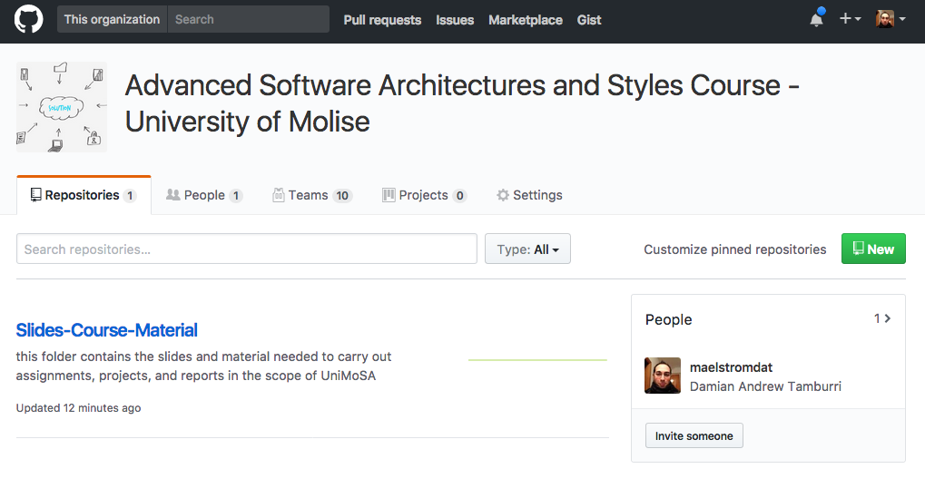
Where do you start?
Navigate to UniMoSA “UniMol Software Architecture Course” Organization on GitHub: https://github.com/UniMoSA

Slide 103
Where do you start?
Navigate on the “team” pane, and enroll yourself in a team!

Slide 104
Where do you start?
Navigate on the “team” pane, and enroll yourself in a team!
You may want to skim through the projects to find the one you want… but…
Be fast! Only teams of 2-3 are acceptable! Make sure you don’t miss your preferred project!
Contact your team-mates, discuss how to proceed/arrange your exploration adventure with your “Pet” project!

Slide 105
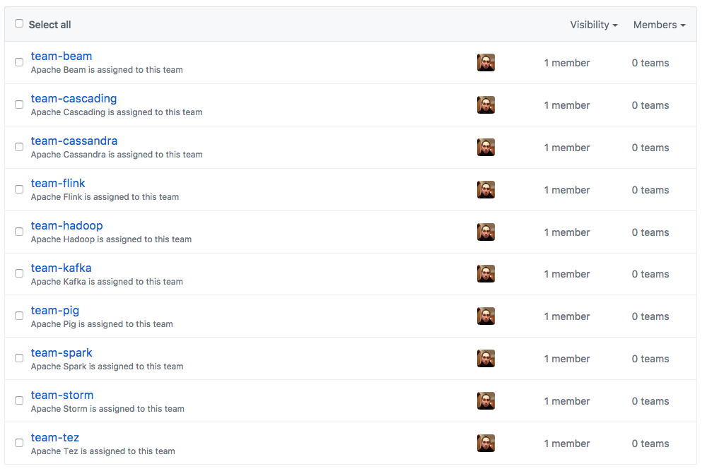
Team Selection = Project Selection!!
Selecting a team equates with selecting a project you’re interested in...

Slide 106
How do you proceed?
Arrange work amongst yourselves to maximise your understanding of your project...
Create your repository using your team name;
Fork the target project into your own repository, and start exploring!!!
You can Commit all you can think of, during your experience, e.g., notes, comments to code, scribbles, drafts of presentations, models…

Slide 107
If you don’t speak GitHub
You should!
Navigate to:
https://guides.github.com/activities/hello-world/
https://readwrite.com/2013/09/30/understanding-github-a-journey-for-beginners-part-1/
http://blog.udacity.com/2015/06/a-beginners-git-github-tutorial.html
After you know what to do (the basics), build your GitHub ID and go back to slide 93!

Slide 108
That’s it for today!
Any Questions?

Slide 109
Further Reading
Zach Holman. How GitHub uses GitHub to Build GitHub. RubyConf, September 2011.
Nick Rozanski and Eoin Woods. Software Systems Architecture: Working with Stakeholders Using Viewpoints and Perspectives. Addison-Wesley, 2012, 2nd edition.
Diomides Spinellis and Georgios Gousios (editors). Beautiful Architecture: Leading Software Engineers Explain How They Think. O’Reilly Media, 2009.
Amy Brown and Greg Wilson (editors). The Architecture of Open Source Applications. Volumes 1-2, 2012.
Software Architecture Wikipedia page (thoughtfully and substantially edited by the IFIP Working Group on Software Architecture in 2012)
Eric Bouwers. Metric-based Evaluation of Implemented Software Architectures. PhD Thesis, Delft University of Technology, 2013.
Remco de Boer, Rik Farenhorst, Hans van Vliet: A Community of Learners Approach to Software Architecture Education. CSEE&T, 2009.
Earlier use of GitHub in the class room by Neil Ernst while at UBC: Using GitHub for 3rd Year Software Engineering, and Teaching Advanced Software Engineering.

